Slide 1
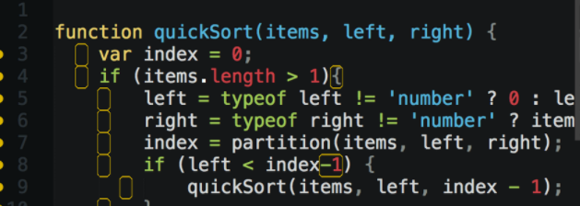
JavaScript Training JS is not perfect but works
Krzysztof Danielewicz
Special thanks to: Maracelina Skopek-, Anton Horetskyi

Slide 2

About me
.net developer with 7 year experience
Expertise in Front-end technologies: JS, angularJS, CSS
Current assignment Total Cost of Ownership for Volvo Penta
Offline web app using Application Cache
AngularJS
The app estimates maintenance cost of Volvo Penta engines.

Slide 3
Agenda
Understanding JS
scopes, closure, hoisting
Objective JS
object literal, prototype, module pattern
ECMAScript5
array functions, strict mode,
Future and necessary fixes
ECMAScript2015, TypeScript, Transpillers

Slide 4

Scopes of variables

Slide 5
Scopes of variable
JavaScript has only two types of scope :
Global scope : Global is nothing but a window level scope. Here, variable present throughout the application.
Functional scope : Variable declared within a function with var keyword has functional scope. Variable declared there are not visible outside.
Notes:
Variable declared in global scopes are avilable
JS Syntax is similar to C syntax languages (Java, C#). Syntax is the same for statements i.e.: while, for, if and function.
lock statements apart from “function” have different behaviour to the modern languages. They do NOT create local scopes with var statement.

Slide 6
“function” create a scope
var temp = ‘OUTER’;
function f1() {
var temp = ‘INNER’;
}
f1();
console.log(temp); // Console prints: ‘OUTER';
Notes:
In this case the global variable temp overrides inside function

Slide 7

“for”, “if”, “while” don’t create a scope
var temp = ‘OUTER’;
for / if / while (…) {
var temp = ‘INNER';
}
console.log(temp); // Console prints: ‘INNER'

Slide 8
IFFE Immediately Invoked Function Expressions
IIFE is a JavaScript function that runs as soon as it is defined.
(function(){
})();
Notes:
Why would you use if?
To Avoid Polluting the Global Scope.
To fix issues with blocks: if, while, for

Slide 9
Fix with IFFE
var temp = 'outer';
for / if / while (…) {
(function () {
var temp = 'inner’;
})();
}
console.log(temp); // Console prints: 'outer'
Notes:
There is A LOT of closure, function in JS.

Slide 10
ECMA2015 – let + const = JS safe scope
ECMAScript 6 (ES6)/ ECMAScript 2015 (ES2015): The 6th edition of ECMAScript, standardized in 2015
ECMA2015 introduces let and const keywords which create scopes for variables and constant in block statements: if, while, for.

Slide 11
Fix with let
var temp = 'outer';
for / if / while (…) {
let temp = 'inner’;
}
console.log(temp); // Console prints: 'outer'

Slide 12

Hoisting

Slide 13
Hoisting
JavaScript mechanism where variables and function declarations are moved to the top of their scope before code execution.
Examples: hosting.js, hosting.2.js
Notes:
Example hositng

Slide 14

Clousure

Slide 15
Clousure
A closure is an inner function that has access to the outer (enclosing) function's variables—scope chain.
The closure has three scope chains:
it has access to its own scope (variables defined between its curly brackets),
it has access to the outer function's variables,
and it has access to the global variables.
Notes:
Usage of closure to emulate private member functions, variables.

Slide 16
Closure example
function makeFunc() {
var name = ‘Volvo’;
function displayNameFn() {
console.log(name);
}
return displayNameFn;
}
var myFunc = makeFunc();
myFunc();
Notes:
More examples VS Code

Slide 17
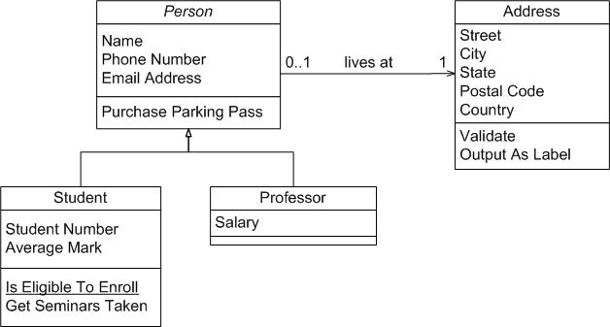
Objective JS

Slide 18
Object literal
var object1 = {
a: 'foo',
b: 42,
c: {}
};
Notes:
examples

Slide 19
Prototype
var Animal = function(name){
this.name = name;
};
Animal.prototype.makeSound = function () {
return ('('+this.name+')');
};
Notes:
One time method, property is defined for all instance of objects.

Slide 20
Module pattern
var MODULE = (function () {
var my = {},
privateVariable = 1;
function privateMethod() {
// ...
}
return { moduleProperty: 1,
moduleMethod: function () {}
};
}());

Slide 21
ECMAScript5 – C# Linq vs array function
C# | ECMAScript5
Where() | filter()
Select() | map()
Any() | some()
All() | every()
Aggregate() | reduce()
ForEach()//List | forEach()

Slide 22
ECMAScript5 – strict mode
Strict mode is a way to introduce better error-checking into your code. When you use strict mode, you cannot, for example, use implicitly declared variables, or assign a value to a read-only property, or add a property to an object that is not extensible
“use strict”;
Only for new code, inside iffe. Strange bugs / behavior for legacy code when is turned of.

Slide 23
Future

Slide 24
Q&A

Slide 25
References
https://app.pluralsight.com/library/courses/javascript-from-fundamentals-to-functional-js/table-of-contents
https://developer.mozilla.org/
“JavaScript: The Good Parts”, by Douglas Crockford

